Slide 1


UNLOCKING A SEAMLESS BANKING EXPERIENCE
Banking Management System
BUILDING THE FUTURE OF BANKING

Slide 2



CONTENT
01
INTRODUCTION
02
SYSTEM OVERVIEW
03
USER INTERFACE DESIGN
04
SYSTEM INTERACES
05
ENTITY RELATIONSHIP (ER) DIAGRAM
06
DATA FLOW DIAGRAM (DFD)
07
CONCLUSION

Slide 3

INTRODUCTION
Welcome to a new era of banking where AS Bank's advanced software is transforming the way you manage your finances. This presentation is your window into the future of convenient and secure banking services

Slide 4

System Overview
Key Features of AS Bank's Banking Solution
Registration for new users.
Secure fund transfers.
Real-time balance checks.
Transaction history at your fingertips.
Effortless withdrawals.
Easy deposits for seamless banking.

Slide 5


User Interface Design
Effortless navigation.
Consistency in layout.
Accessibility for all users.
Clear and informative feedback.

Slide 6

System Interfaces
Secure communication with the MySQL backend database.
Data storage and retrieval for users and transactions.
Scalability for accommodating future growth.
Our app can give output in xlsx format of all transaction

Slide 7



ER DIAGRAM

Slide 8
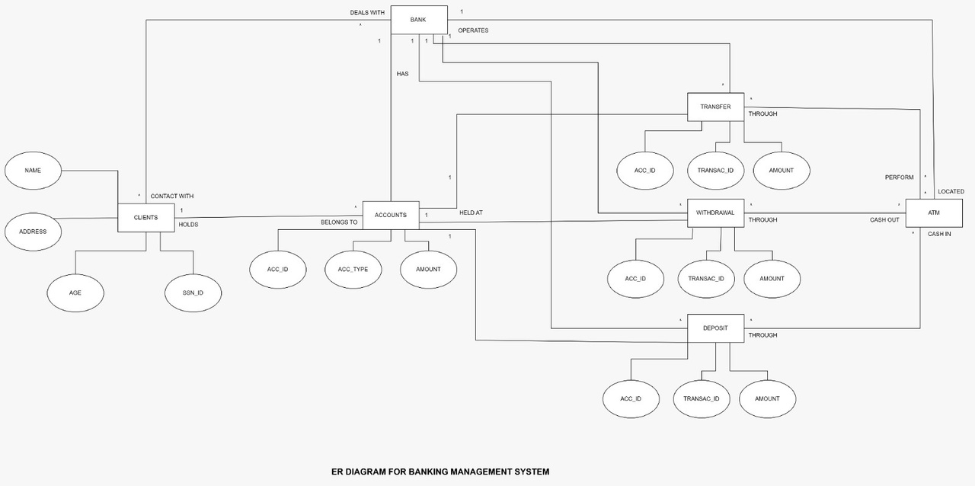

ER DIAGRAM
An Entity-Relationship (ER) diagram is a visual representation used in database design to depict the data model of a system. It illustrates the entities (objects, concepts, or things) within a system, their attributes (properties or characteristics), and the relationships (associations or connections) between these entities. ER diagrams provide a clear and concise way to define the structure and organization of data in a database, helping to understand and document how various data elements interact with each other

Slide 9

Data Flow Diagram (DFD)

Slide 10
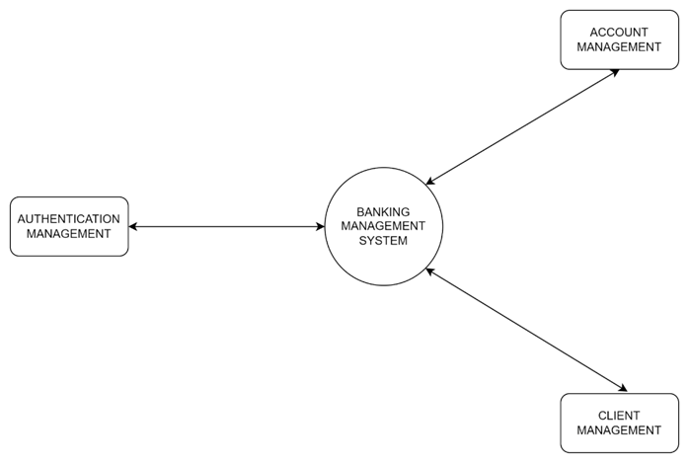

LEVEL ZERO DFD
A level zero data flow diagram, also known as a context diagram, provides a high-level overview of the entire system. Here the system works as a single process box and the entities outside the system that interact with it. It shows the flow of data into and out of the system.

Slide 11
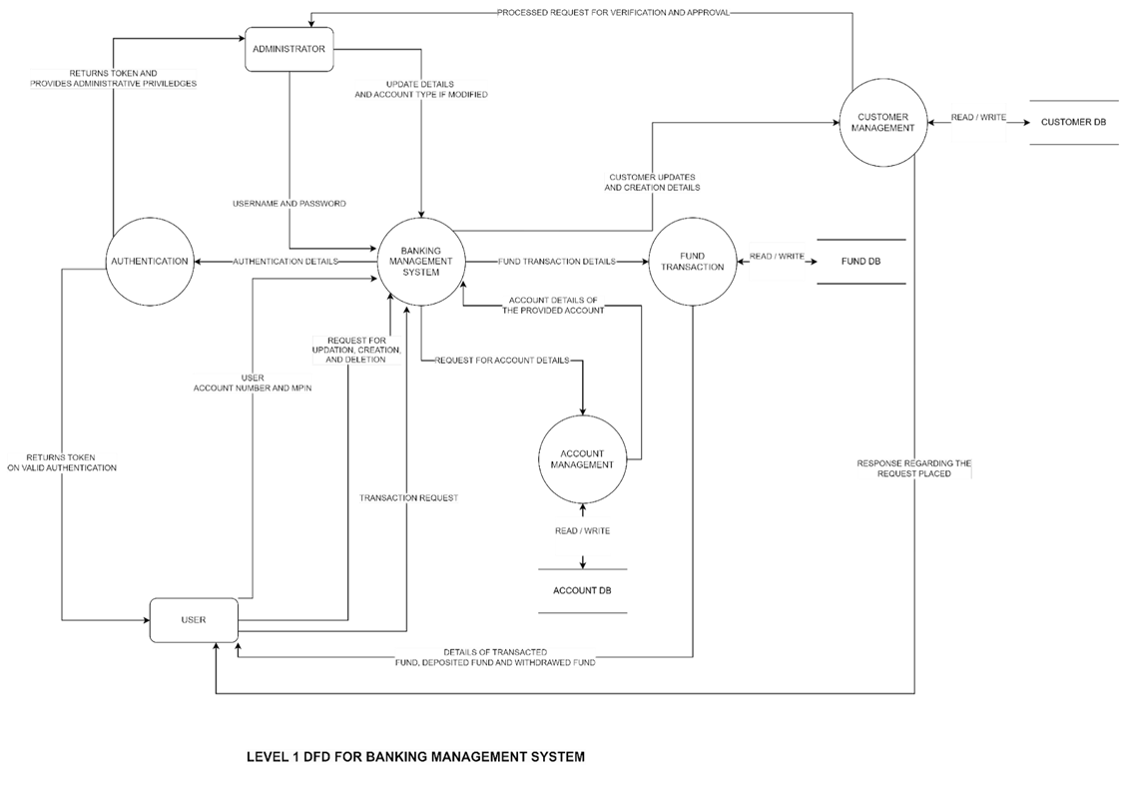
LEVEL ONE DFD
Level 1 DFDs are still a general overview, but they go into more detail than a context diagram. In level 1 DFD, the single process node from the context diagram is broken down into sub-processes. As these processes are added, the diagram will need additional data flows and data stores to link them together.

Slide 12
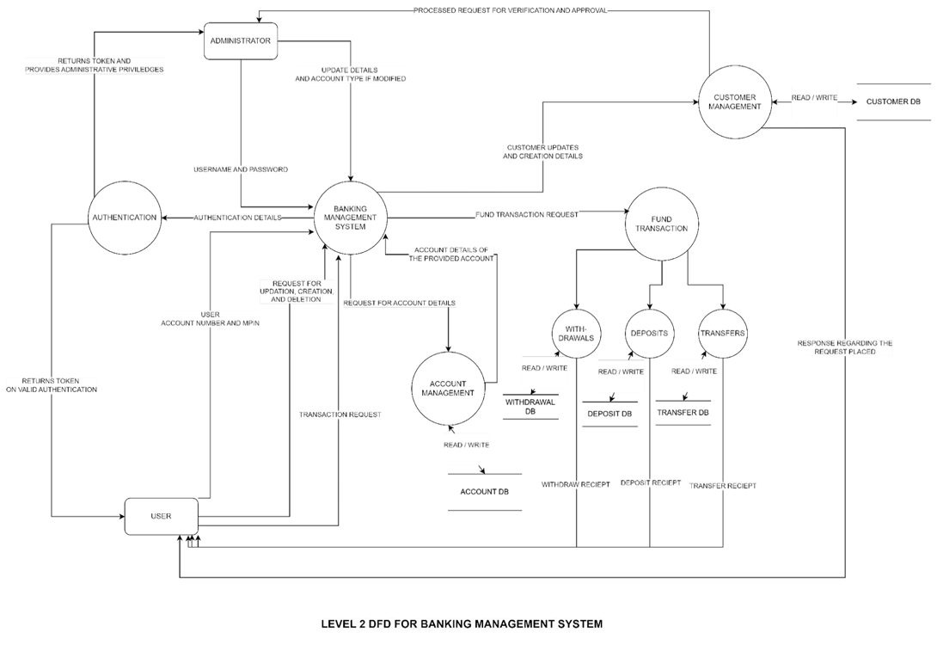
LEVEL TWO DFD
A level 2 DFD is a resplendent data flow diagram that provides a more refined perspective of a system, offering greater clairvoyance into a particular system design. In addition to having processes and entities connected with arrows to signify the utilization and dataflow, the level 2 DFD also has the aspect of data storage which is done through databases.

Slide 13
CONCLUSION
AS Bank's innovative banking system is poised to redefine your banking experience. With a focus on security, accessibility, and user-friendliness, we're committed to providing you with a seamless and secure platform for managing your finances. From user registration to fund transactions, real-time balance checks, and a user-friendly interface, our system is designed to meet your needs in the digital age. With dependable system interfaces and robust data management, we ensure that your financial information remains safe and accessible. We invite you to be a part of the future of banking, where convenience and security are at the forefront. Thank you for joining us on this exciting journey

Slide 14

THANK YOU

